Slide 1
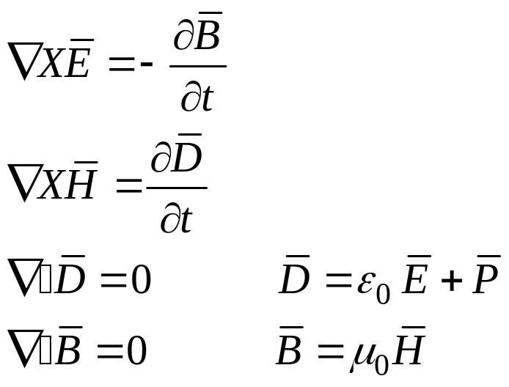
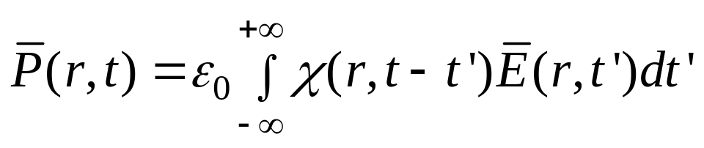
Wave propagation in optical fibers
Maxwell equations in differential form
The polarization and electric field are linearly dependent

Slide 2
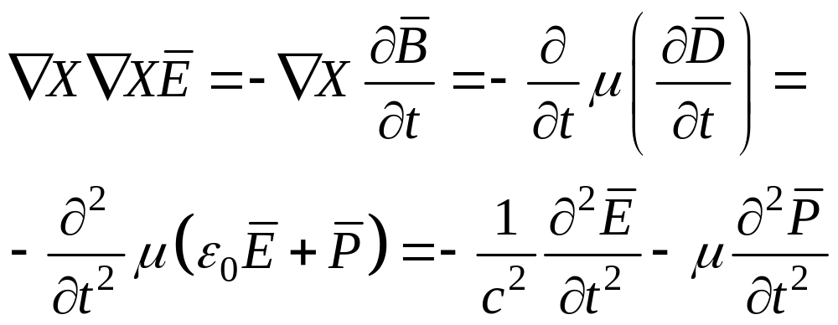

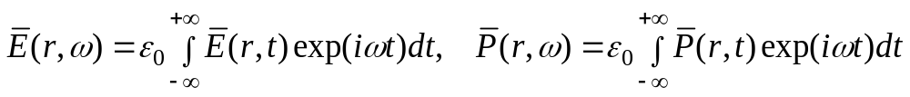
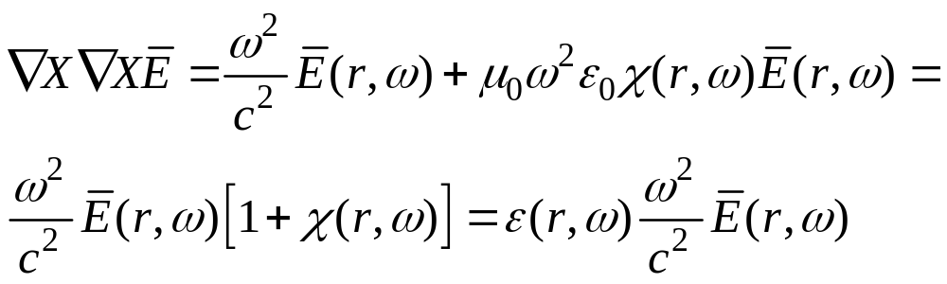
Fourier transformation of
and substituting leads to

Slide 3
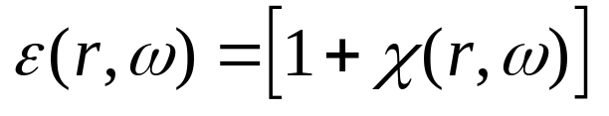
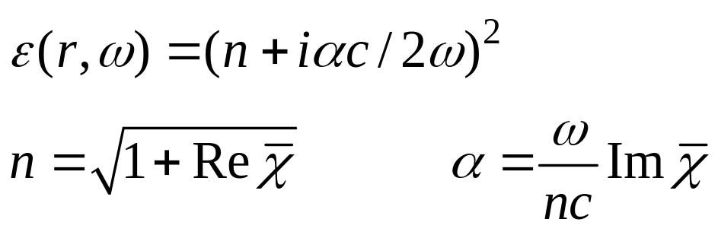
Is defined as the complex frequency dependent
Dielectric constant
Refractive index Absorption (loss)
n and α frequency dependent.
The solution to the propagation problem is vastly simplified by introducing
the so called Gloge Approximation which assumes that
α = 0 or ε = n²
II) n is independent of r or Δn = 0

Slide 4
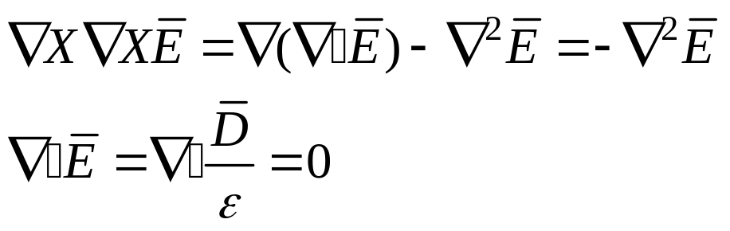
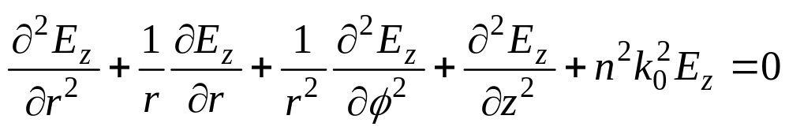
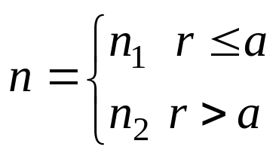
Using the identity
Leads to the wave equation
In cylindrical coordinates, the equation for E_{z} (for example) is
There are similar equations for E_{φ} E_{r} H_{z} H_{φ} H_{r}. Only two need to be solved

Slide 5
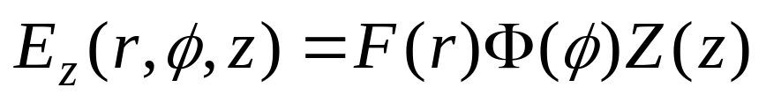
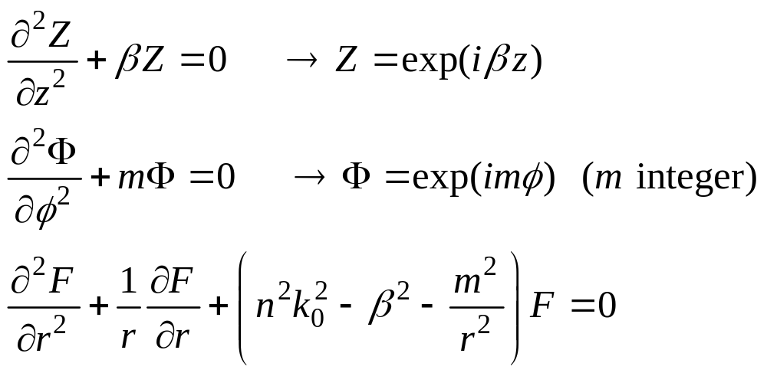
The wave equation is solved by separation of variables
This leads to three regular differential equations

Slide 6
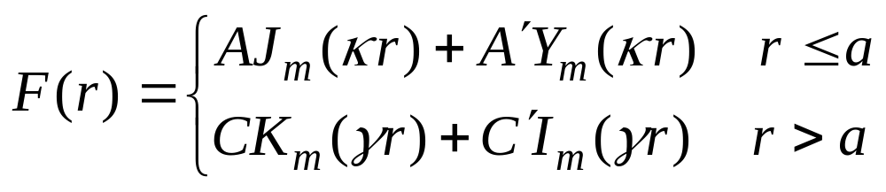
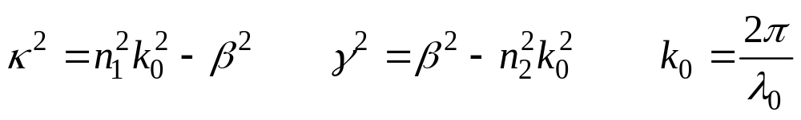



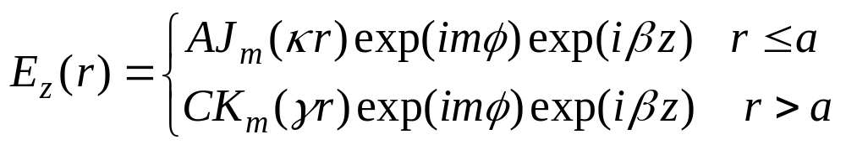
Solution to the equation for F(r)
with
Jm, Ym, Km, Im are Bessel functions and A,A’,C,C’ are constants
The field has to be finite at and zero for large
The field E_{z} becomes then

Slide 7
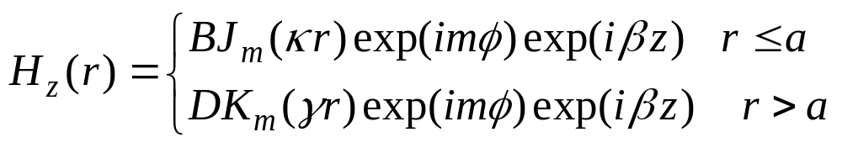
Similarly for H_{z}
The form of the Bessel functions is
1
10
K0(x)
J0(x)
9
K1(x)
J1(x)
K2(x)
J2(x)
8
0.5
7
6
5
4
0
3
2
1
-0.5
0
x
0
1
2
3
4
5
6
7
8
9
10
0
0.5
1
1.5
2
2.5
3
x

Slide 8
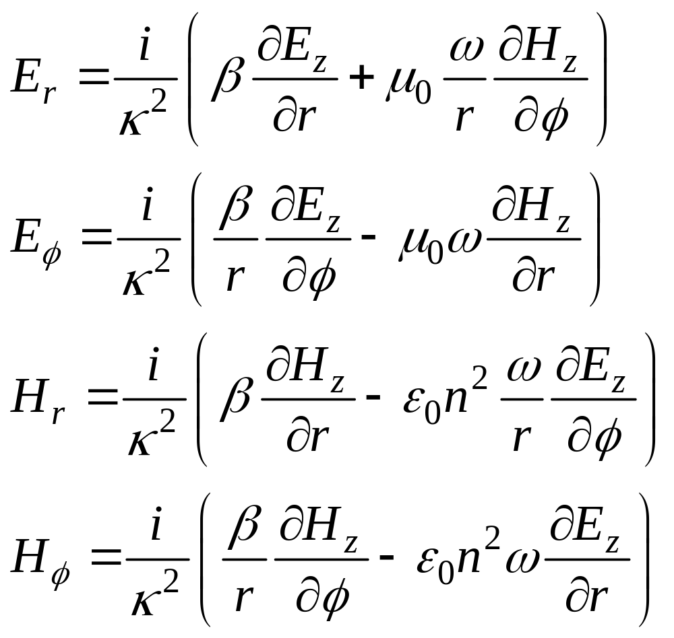
The Maxwell equations are used to calculate the four other field components

Slide 9
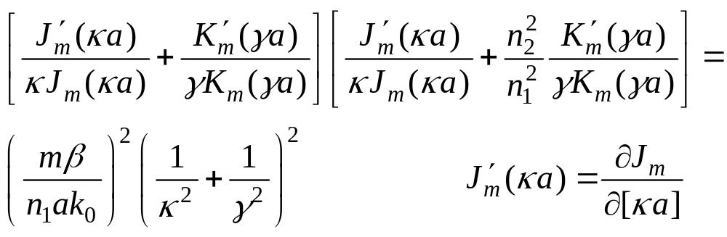
There are now six equations describing all the fields in the core and
in the cladding. There are four coefficients A B C D which need to be
computed. The coefficients are found using the boundary condition
The boundary conditions yield four equations which have to be
satisfied simultaneously. The determinant of this set of equations
is set to zero and this leads to the important Eigenvalue Equation for
the propagation constant β

Slide 10
The Eigenvalue equation is cumbersome relative to the case of a dielectric
slab. Even for the dielectric slab, the solutions are not intuitive and have to
be found numerically and some times graphically.
Given a fiber and an operating wavelength, n₁ n₂ a, k₀ the Eigenvalue equation
can be solved (at least numerically) to yield the propagation constant β for
the specific mode solved for.
The solutions are periodic in m and are counted successively
so a mode is labeled β_{mn} n = 1, 2, 1 . . .
Each β_{mn} represents a field distribution described by the six field equations.
In general E_{z} and H_{z} are non zero, except for the case of m = 0.
The modes are labeled HE_{mn} or EH_{mn} and for m=0, TE_{0n} or TM_{0n}.
Some times the modes are labeled LP_{mn}

Slide 11
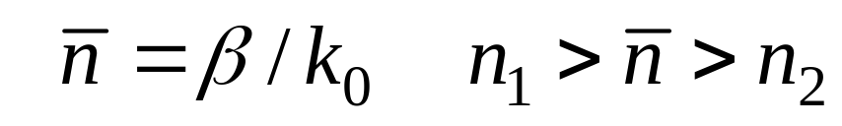

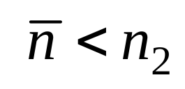
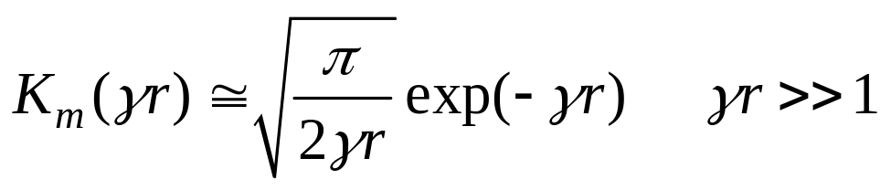
Define modal index
A given mode with a given β defines and this is the index
that mode experiences. For example established the phase velocity
of that mode.
When changes, say because the wavelength (and therefore k₀) changes
the mode may reach cut off
Cut off The mode is no more guided.
For a propagating mode, the field changes in the cladding
According to

Slide 12
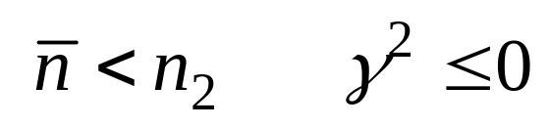
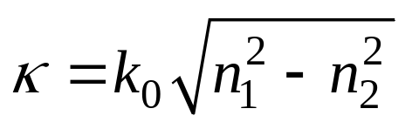
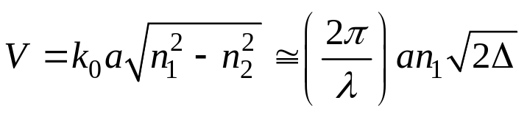
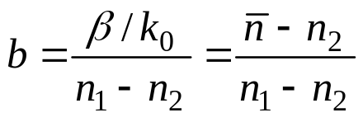
At cut off
and hence there is no exponential field reduction and no guiding.
At cut off
Normalized Frequency V
Define
V is proportional to
ω or 1/λ or k₀
Normalized propagation constant b
Define

Slide 13
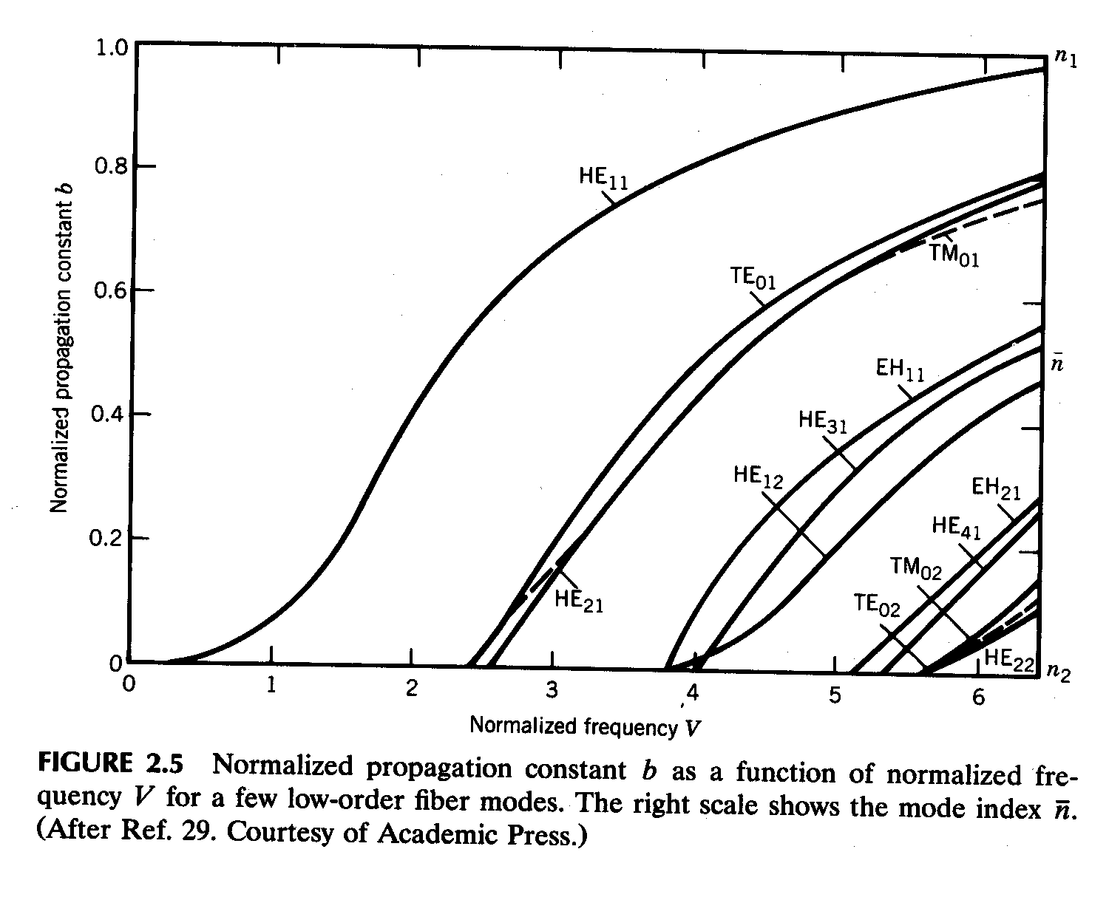
B versus V
Given a frequency or wavelength, V is completely defines for a given fiber
A large V number yield many modes
A very approximate and crude rule of thumb states that the number of
modes is V²/2

Slide 14
For small V numbers the number of modes is small, V = 5 yields 7 modes
The most important case is that for which there is only one mode
Single Mode Conditions
A single mode, HE₁₁ is obtained when all other, higher, modes are cut off.
Inserting m = 0 in the Eigenvalue equation
Cut off in the TE_{0n} modes
Cut off in the TM_{0n} modes

Slide 15
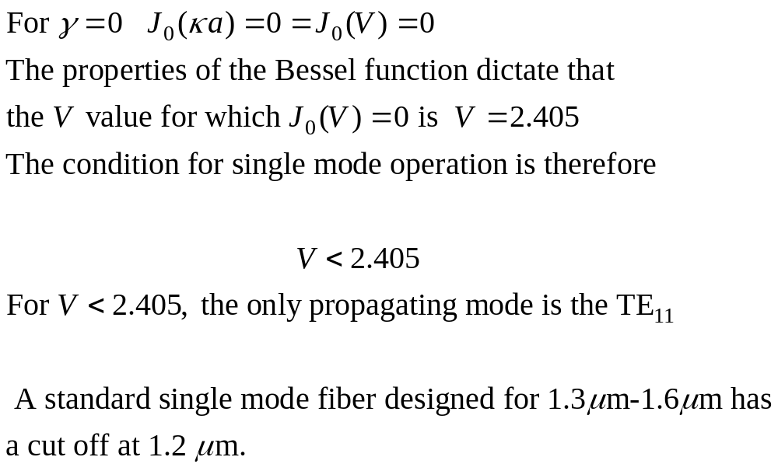

Slide 16
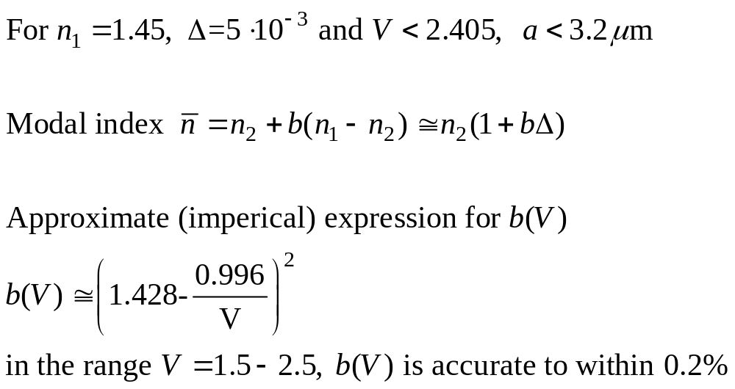

Slide 17
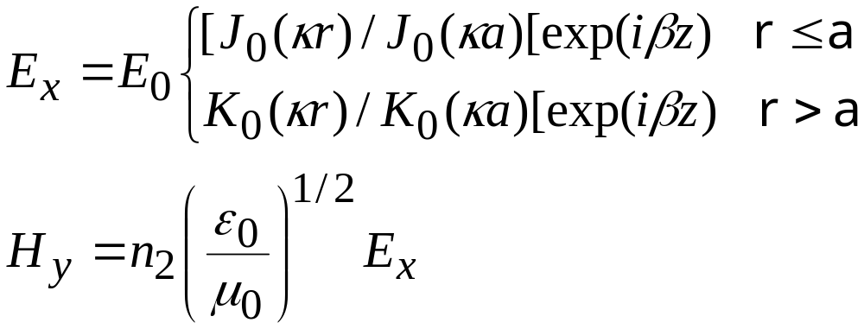
Field distribution
The fundamental mode of the fiber is such that in general it
is linearly polarized along E_{x} or E_{y}.
For E_{x}
Actually, there always exists another mode E_{y} and in theory the
two modes have the same

Slide 18
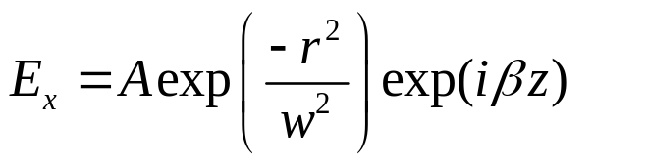
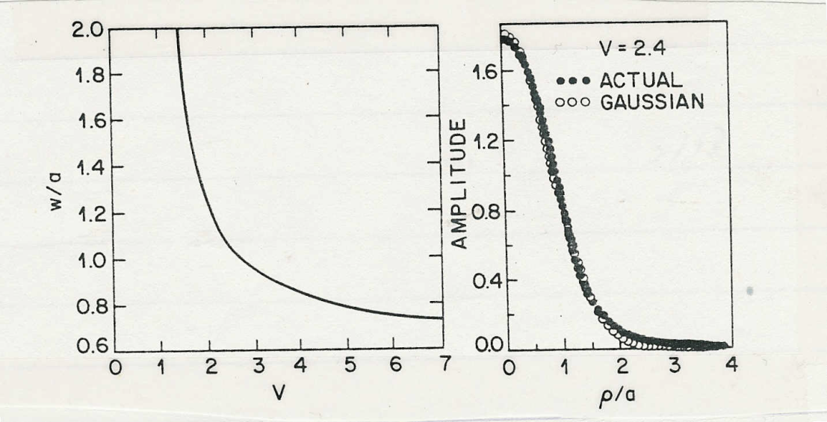
Spot size
The basic field distribution is a Bessel function for which is it
hard to develop a simple intuitive picture. The field distribution
can be approximated by a Gaussian so that
w is the spot size

Slide 19
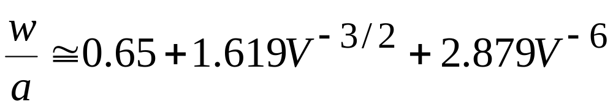
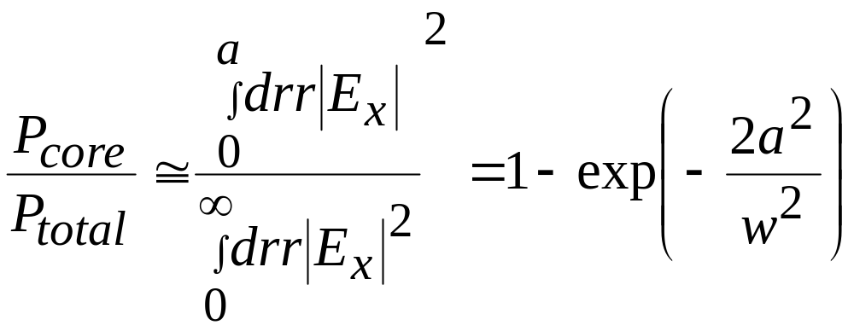
W and a are related by a formula
Also, the spot size determines the confinement factor

